Slide 1

Chapter 17
How to design a web site
Notes:
Session: Ghi số thứ tự session trong môn học
Session Name: ghi tên của session sẽ dạy

Slide 2
Objectives
How to design a website
Users and usability
Design guidelines
Other design considerations
Notes:
Mô tả nội dung mà học viên phải đạt được khi kết thúc môn học này

Slide 3
Users and usability
Notes:
Mô tả nội dung chi tiết từng chuyên đề

Slide 4
What web user want is usability
Usability refers to how easy it is to use a web site, and usability is a critical requirement for an effective web site
What website users want
How web site users use a web page
Notes:
Mô tả nội dung chi tiết từng chuyên đề

Slide 5
Guidelines for improving usability
Three guidelines for improving usability
Present all the critical information “above the fold” so the user doesn’t have to scroll
Group related items into separate components, and limit the number of components on each page
Adhere to the current conventions for web site usability

Slide 6
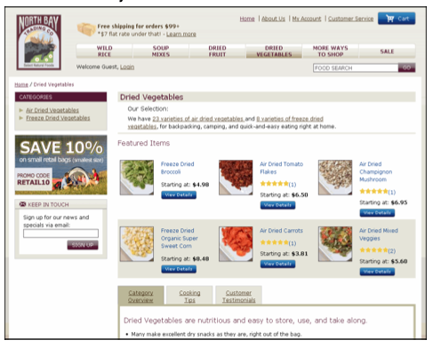
A website that is easy to use

Slide 7
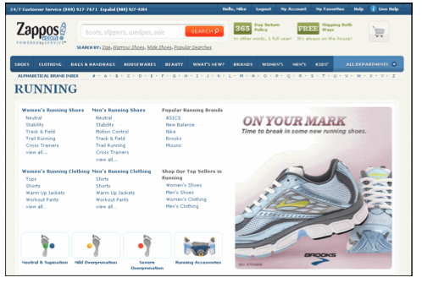
The current convention for usability
To Use web sites for a while, you expect certain aspects of each web site to work the same way
A web page that illustrates some of the current web site conventions

Slide 8
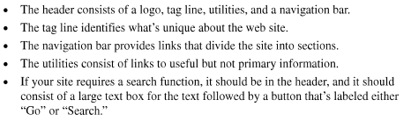
The current convention for usability
Header conventions

Slide 9
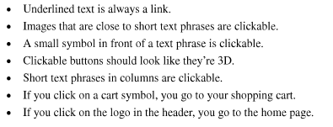
The current convention for usability
Navigation conventions

Slide 10
Design guidelines

Slide 11
Use the home page to sell the site
Homepage Usability by Jakob Nielsen and Marie present 113 guidelines for home pages, plus an analysis of the home pages for 50 web site.
10 guidelines for developing an effective home page

Slide 12
10 guidelines for developing an effective home page
Emphasize what your site offers that’s valuable and how your site different from competing sites.
Emphasize the highest priority tasks of your site so users have a clear idea of what they can do.
Don’t welcome users to your site because that’s a waste of space.
Group items in the navigation area so similar items are next to each other, and don’t provide multiple navigation areas for the same type of the links.
Only use icons for navigation if the users will readily recognize them.

Slide 13
10 guidelines for developing an effective home page (2)
Using drop-down menu sparingly, especially if the items aren’t self-explanatory.
Design the home page so it is different from other page of this site.
Don’t include an active link to the home page on the home page
Code the title for the home page as the organization name, followed it by a short description, and limit the title to 8 or fewer and 64 or fewer characters.
If your site provides shopping, include a link to the shopping cart on your home page.

Slide 14

A home page that tries to sell the site

Slide 15
Let the users know where they are
As your site gets more complex, the users are likely to lose track of where they are in the site.
How to let the users know where they are
Highlight the active links
The heading for the page should be the same as the links that led to the page
Provide breadcrumbs in this format: Homepage -> Men -> Shoes & Sandals

Slide 16
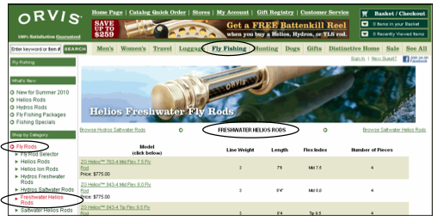
Let the users know where they are
A product page with the active links highlighted

Slide 17
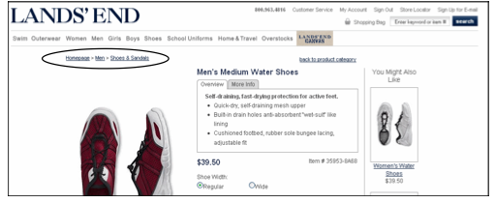
Let the users know where they are
A product page that provides breadcrumbs

Slide 18
Make the best use of web page space
The most valuable space on each web page is the space above the fold. To get the most from it, you need to prioritize the components on each page and give the best location to the highest-priority components
Guidelines for the effective use of space
Keep the header relatively small
Prioritize the components for each page
Give the most important components

Slide 19

Make the best use of web page space
Wasted space on a primary page

Slide 20
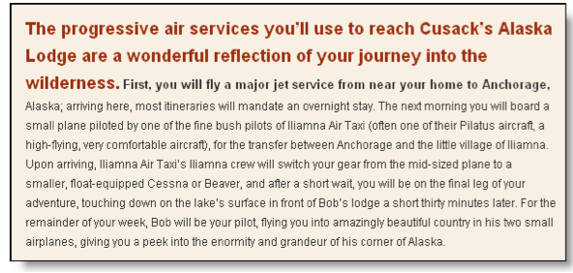
Write for the web
Writing that isn’t for the web

Slide 21
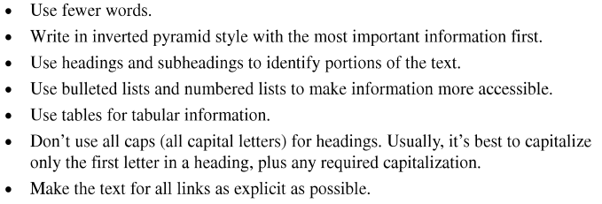
Web writing guidelines

Slide 22
Chunk long page into shorter pages
Chunking refer to the grouping of content into chunk that can be presented on separate web pages. This lets user select the chunks of information that they’re interested in.
Two pages with chunks of information about a book

Slide 23
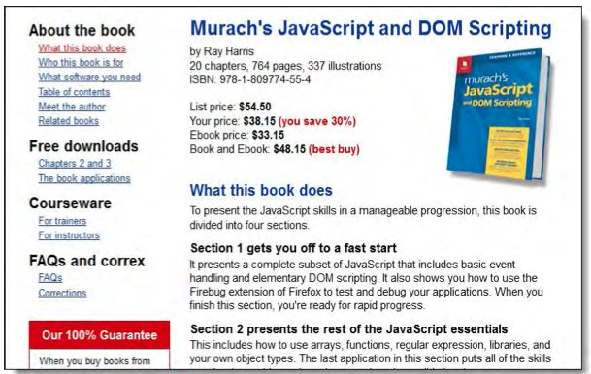
Chunk long page into shorter pages
What this book does

Slide 24
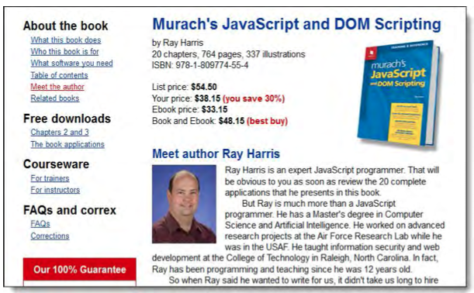
Chunk long page into shorter pages
Meet the author

Slide 25
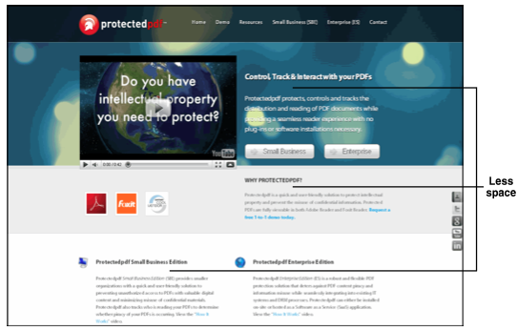
Know the basic principles of graphics design
home page that doesn’t obey the graphics design principles

Slide 26
Know the basic principles of graphics design
Four principles of graphics design
Alignment
Proximity
Repetition
Contrast

Slide 27
Know the basic principles of graphics design
Typographical guidelines
Limit the line length of paragraphs to 65 characters
Use a sans serif font in a size that’s enough for easy reading
Show the relationships between heading and the text that follows by keeping them close
Use dark text on the light background and don’t use an image for the background
Don’t center text and don’t justify text
If you indent the first lines of paragraph, you don’t need space between the paragraphs
Don’t use reverse type for text

Slide 28
How to design a webpage

Slide 29

The lifecycle of a web site
The lifecycle of all systems is design, implement, and maintain.
The lifecycle of a web site

Slide 30
Steps to design a webpage
Define the audience and set the goals
Develop the site map
Wireframe the critical pages
Illustrate the critical pages

Slide 31
The design procedure applied to a small web site

Slide 32
Define the audience and set the goals
About Town Hall
The target audience
The goals of the website
Design the home page

Slide 33
Design the primary content pages
To get the design started, sketch or prototype the home page. After you agree on the design of the home page, sketch or prototype one of the primary contents pages
Use stepwise refinement to get these pages working the way

Slide 34

Design the primary content pages
A prototype for the home page

Slide 35

Design the primary content pages
A prototype for a primary content page

Slide 36
Design the other pages
The other pages that are needed
Post-lecture luncheon
Pre-lecture discussions
Saroyan Theater
Special donors
About us
Contact us

Slide 37
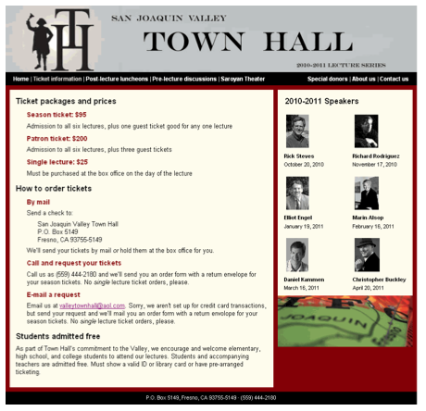
Design the other pages
The ticket information page

Slide 38
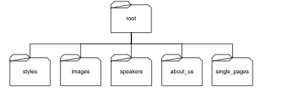
Plan the folders for the site
To document the navigation for the web site, you can develop a site plan that shows all of the pages that the web site requires. The site plan should also the number of levels in the navigation structure
The folder for the web site

Slide 39
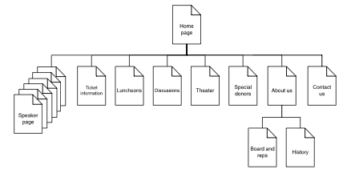
The site plan for the web site

Slide 40
Other design consideration

Slide 41
The use of development teams
Web designer is a term that’s often confused with graphics designer
Typical members of a development team
For Design | For implementation
Web designer | HTML and CSS specialists
Writers | Client-side programmers
Marketing specialists | Server-side programmers
Graphics designs | Database administrator
 | Network administrator

Slide 42
The use of development teams
Web designer vs Graphics designer
Web designers participate in all places of web design
Graphics designers focus on the graphics that make web pages work better and look more inviting

Slide 43
Summary
Use usability is the primary issue
Highlight the active links on the page
Chunking refers to the grouping of information into topics.
Use principles of alignment, proximity, repetition, and contrast
A web designer, A graphics designer
The lifecycle of all system consists of design, implementation and maintainer
Defining its target audience and goals
Site plan
Notes:
Tóm tắt lại nội dung đã học

